Slide 1



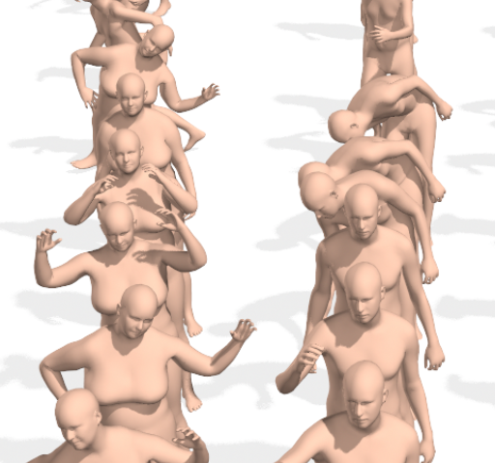
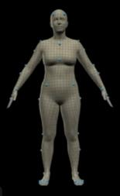
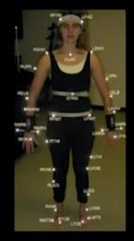
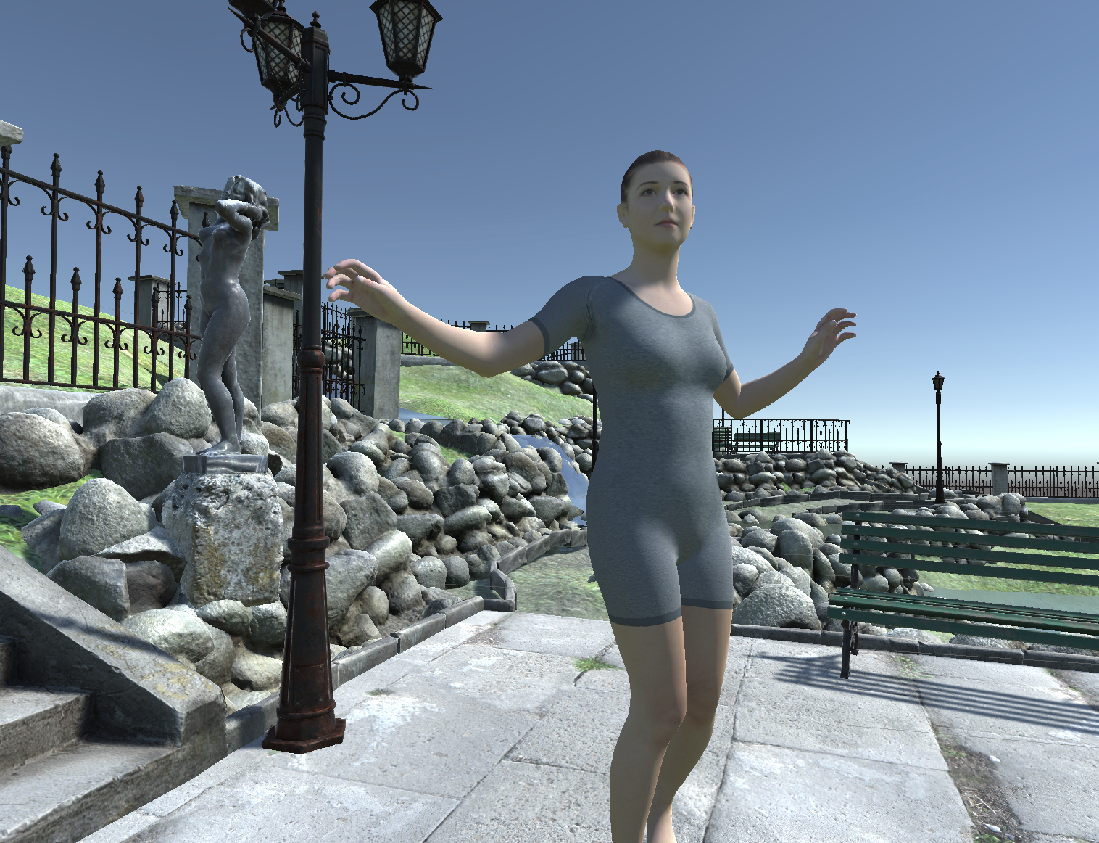
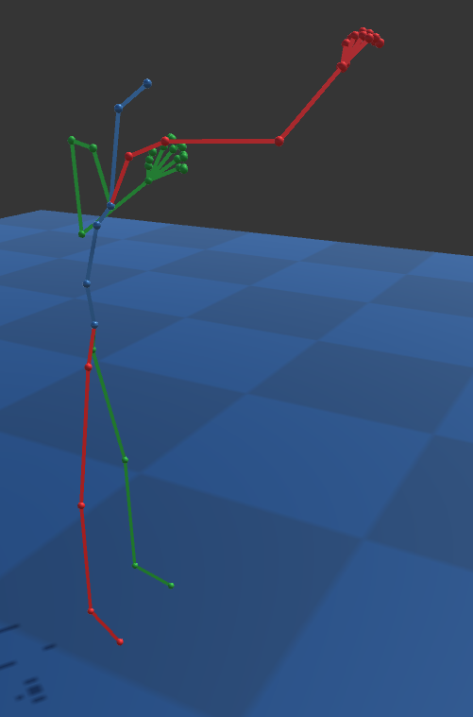
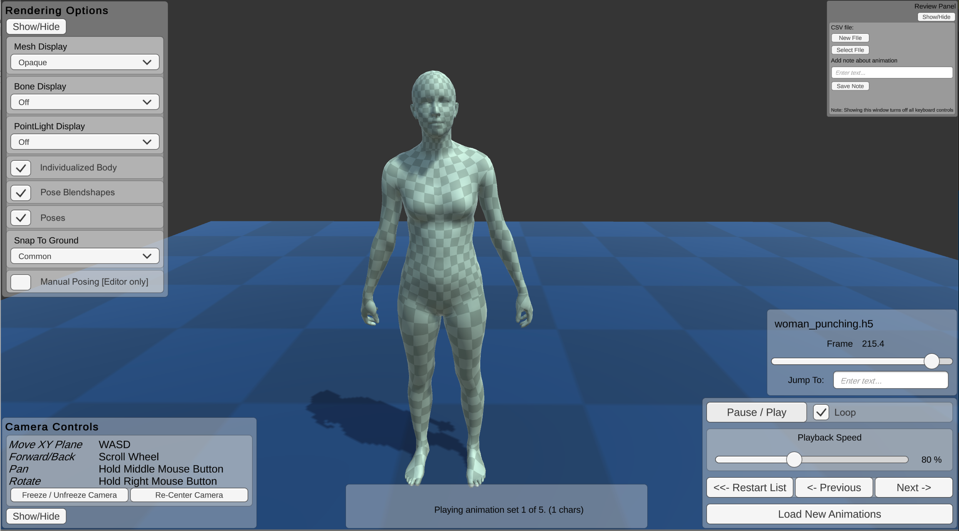
bmlSUP – A SMPL Unity Player
Adam O. Bebko, Anne Thaler, Nikolaus F. Troje
Centre for Vision Research, York University, Toronto, Canada
Center for
Vision Research
Contact: Adam O. Bebko | adambebko@gmail.com | IEEE VR 2021, March 27th – April 3rd 2021
Realistic virtual characters are important for many applications. The SMPL body model is based on 3D body scans and uses body shape and pose-dependent blendshapes to achieve realistic human animations [3]. Recently, a large database of SMPL animations called AMASS has been released [4]. Here, we present a tool that allows these animations to be viewed and controlled in Unity called the BioMotionLab SMPL Unity Player (bmlSUP). This tool provides an easy interface to load and display AMASS animations in 3D immersive environments and mixed reality. We present the functionality, uses, and possible applications of this new tool.
AMASS Database
SMPL-H Model
Optical Motion Capture
AMASS is a large database of animated realistic body models performing a wide variety of
everyday actions (https://amass.is.tue.mpg.de/) [4]. ​
The animations are based on the SMPL body model [3, 4]. The SMPL-H extension adds support for hand animation
SMPL animations are generated from optical motion capture data using the MoSh++ pipeline [2].​
Currently, AMASS animations aren't easily compatible with tools that can display realistic 3D environments and VR.​
bmlSUP​​
Easily render AMASS body animations in Unity Game Engine​
The BioMotionLab ​
SMPL Unity Player​
Free and open source
https://biomotionlab.github.io/SUP
bmlSUP playing a textured AMASS animation in VR.
Easy Loading: Animation files can be loaded individually or in batch either from code or from a GUI. Multiple or paired animations can be played simultaneously.
Advanced customization: options are available via the Unity Editor, including changing the background scene, the rendering and textures of the body models, and many other features.​ See above image for example of a realistic scene.
Modular and Unity-Compatible: The individualized body meshes and animations are compatible with Unity's Mecanim and Adobe Mixamo. The body shape is also completely indepement from the posing system, allowing for interesting applications like redirecting motions from an actor to other bodies.
Appearance: There are three mesh rendering modes: Opaque (checkerboard or custom texture), Semi-Transparent, and No Mesh. Rendering of lines for bones and spheres for all joints can be toggled on and off. The left and right sides of the body can be colored separately.
Reviewing: Save notes about animations while viewing them. This can be used to annotate large sets of animations, and for simple applications requiring basic user responses.
Camera: The camera can be explicitly positioned in the Unity editor before runtime. There are also runtime camera controls that roughly match the controls of the Unity Editor scene view.
Playback Controls: controls are provided for Play and Pause, Playback Speed, a “scrubber” for jumping to a particular part of the animation. There are also controls to navigate a list of several animations.
Rendering bones and joints only
Potential Applications
Psychology Experiments: BmlSUP can serve as a template for designing behavioural experiments involving realistic body models. This can be done Accomplished easily and quickly with bmlTUX, another tool created by our group. BmlTUX provides an interface in unity to quickly build VR-compatible behavioural experiments. The toolkit is available open source from: https://biomotionlab.github.io/TUX
Realtime Self-Avatar Animation: bmlSUP implements body shape and pose independently. Once an individual's body shape is determined, their individualized SMPL body can be animated in real-time from data streamed from optical motion capture systems.
To determine a user's individual body shape parameters, The Virtual Caliper project (https://virtualcaliper.is.tue.mpg.de) provides tools to rapidly generate metrically accurate SMPL bodies based on fast body measurements. The bodies can be generated either within Unity using virtual reality controllers, or by setting the body dimensions in a desktop application.
Mixed Reality: bmlSUP can be used to leverage Unity's mixed reality support, greatly simplifying presenting AMASS animations in mixed reality applications. Potential avenues of research could include ergonomics and design testing, the growing field of fitness and health body-shape tracking, and studies improving body realism in gaming.
References​K
J. Romero, D. Tzionas, and M. J. Black. Embodied hands: Modeling and capturing hands and bodies together. ACM Transactions on Graphics (ToG), 36(6):245, 2017.​
N. Mahmood, N. Ghorbani, N. F. Troje, G. Pons-Moll, and M. J. Black. AMASS: Archive of motion capture as surface shapes. In Proceedings of the IEEE ICCV, pp. 5442–5451, 2019.​
M. Loper, N. Mahmood, J. Romero, G. Pons-Moll, and M. J. Black. SMPL: A skinned multi-person linear model. ACM transactions on graphics (TOG), 34(6):1–16, 2015.​
M. Loper, N. Mahmood, and M. J. Black. MoSh: Motion and shape capture from sparse markers. ACM Transactions on Graphics (TOG), 33(6):1–13, 2014.​
A. O. Bebko and N. F. Troje. bmlTUX: Design and control of experiments in virtual reality and beyond. i-Perception, 11(4):2041669520938400, 2020.​
S. Pujades, B. Mohler, A. Thaler, J. Tesch, N. Mahmood, N. Hesse, H. H. Bülthoff, and M. J. Black. The Virtual Caliper: Rapid Creation of Metrically Accurate Avatars from 3D Measurements. IEEE transactions on visualization and computer graphics, 25(5):1887–1897, 2019.​

